Slide 1
Informal presentation for computational linguists who work on events in biomedical texts
Foundations of Events in Linguistics:
Vendler 1957

Slide 2

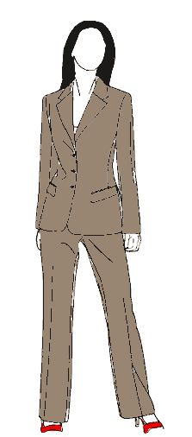
An example situation
When provoked, Notaden bennetti frogs secrete a proteinaceous exudate, which rapidly forms a tacky and elastic glue.
This material has potential in biomedical applications.

Slide 3
Activities
running,
walking,
swimming,
pushing or pulling something,
etc

Slide 4
Accomplisments
painting a picture,
making a chair,
building a house,
writing or reading a novel,
delivering a sermon,
giving or attending a class,
playing a game of chess,
growing up,
recovering from illness,
getting ready for something

Slide 5
Acheivements
recognizing,
realizing,
spotting and identifying something,
losing or finding an object,
reaching the summit,
winning the race,
crossing the border,
starting, stopping, and resuming something,
being born, or dying

Slide 6
States
having,
possessing,
desiring, or wanting something,
liking, disliking, loving, hating,
ruling, or dominating somebody or something,
knowing or believing things

Slide 7
What are the features?

Slide 8
Levels of abstraction
A further abstraction, ignoring many grammatical components of the sentence
proposition
An abstraction of the grammatical and lexical content of an utterance
sentence
Bound to a specific situation, a specific speaker
utterance

Slide 9
Sentences vs. propositions
A sentence is a linguistic construct. From a linguistic point of view, these are different sentences:
  John stole the meat pie.
  The meat pie was stolen by John.
A proposition is a logical construct, which abstracts away from grammatical differences.
If we simplify things, we could view the above sentences as expressing the same proposition:
  “There is an x, and there is a y: x is a meat pie and y is a person called John, and y stole x”
  Logicians would express the above using some form of notation.

Slide 10
Conceptual structure and language
Presumably, words and constituents map to conceptual elements.
E.g. Jackendoff (2002) proposes a three-level theory of language:
  phonological structure
  syntactic structure
  conceptual structure
  Rules to map from one level to the other.
  The rules mapping from linguistic to conceptual structure define an interface between language and other cognitive functions.
purely linguistic
purely linguistic
general cognition

Slide 11
Other theories
Other theories (contra Jackendoff), propose a level of semantic structure which is “properly” linguistic.
This intervenes between conceptual structure and linguistic structure.

Slide 12
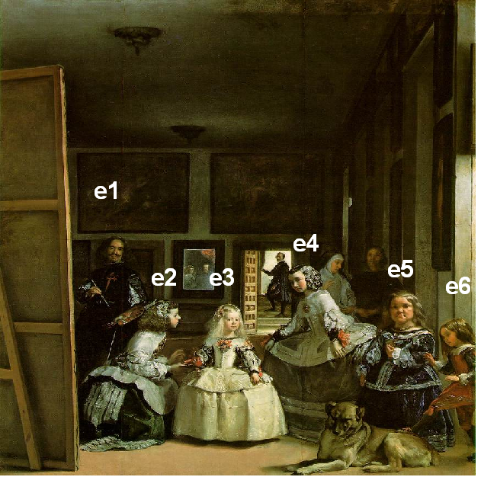
Reference
Imagine you’re standing in front of this painting. Your partner asks:
Which of those figures is the Princess of Spain?
You know that it’s the figure marked “e3”
Diego Velazquez, Las Meninas
(Museo Prado, Madrid)

Slide 13
Reference
There are many ways to reply:
  the girl in the white dress
  the girl in the middle
  the person being tended to by the kneeling maid
Diego Velazquez, Las Meninas
(Museo Prado, Madrid)

Slide 14
Reference
These different expressions mean different things, have different content.
However, they all pick out the same entity in this context (the Princess of Spain).
  i.e. they refer to the princess of Spain
In a different context, the girl in the white dress could pick out something different.
  Sometimes, it can fail to pick out anything.

Slide 15
Reference
an action on the part of a speaker
it is context-bound
but how do we pull it off?

Slide 16
Meaning and grammar (I)
Generative grammar divides the language faculty into modules:
This view emphasises distinct roles played by different components.
There is a separate component for meaning.
phonology
syntax
semantics

Slide 17
Meaning and grammar (II)
An alternative view, found for example in Cognitive Grammar, argues that meaning is inseparable from the other components.
In this framework, people often argue also that linguistic knowledge and encyclopaedic knowledge cannot be separated.
phonology
syntax
semantics

Slide 18
Semantics in relation to philosophy
Philosophical concerns:
  Ontology:
    the nature of reality, what is “out there”
  Epistemology:
    How we come to perceive and know about “what is out there”
Semantics must account for:
  How words and sentences relate to “things” and “situations”
  How we come to know those relationships.
In fact, a lot of work in semantics is influenced by work in philosophy.

Slide 19
Semantics in relation to psychology
Psychologists have long been interested in the nature of concepts:
  Concepts are the basic building blocks with which we think
  How are concepts organised?
  How are they acquired?
Concepts are often assumed to underlie the meanings of words.
Results from psychology have often informed semantic theory.

Slide 20
Semantics vs. pragmatics
Many linguists make a distinction between
  Literal/conventionalised meaning
    “core meaning”, independent of context
    This belongs to semantics proper
  Speaker meaning & context
    What a speaker means when they say something, over and above the literal meaning.
    This and other “contextual” effects belong to pragmatics
NB. The distinction between semantics and pragmatics is not hard and fast
  Is the context-dependent meaning of you a matter for semantics or pragmatics?

Slide 21
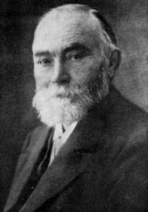
Frege
German philosopher and mathematician
Considered to be one of the founding fathers of modern semantic theory and logic.
Formalised the distinction between sense and denotation in an article
  Uber Sinn und Bedeutung (1892)
  “On sense and denotation”
Gottlob Frege
1848-1925

Slide 22
Definiteness & Specificity & Quantification
Entities
Predicates

Slide 23
Indefinite expressions
Prototypically, these are NPs with an indefinite article (“a”).
But also:
  Come up and see me sometime.
  Some chappie called the other day.
  Certain people are just obnoxious.
  This driver she met was kind of cute.

Slide 24
Specific vs. non-specific
To get the door to open, you have to say a word.
Has at least 2 readings:
  …you have to say any word that comes to mind. (non-specific)
  …you have to say a special word that the speaker may or may not know. (specific)

Slide 25
Definites vs. specific indefinites
Like definite NPs, specific indefinites carry the suggestion that the identity of the entity is relevant.
  …you have to say a word
  not any word, but a specific word will do the trick
However, with a specific indefinite, the speaker is not signalling to the hearer that identification is essential.

Slide 26
Markers of specificity
In English, a certain is often used to mark specific indefinites:
  A certain woman is said to have married him in secret.
In Maltese, the determiner wieħed/waħda (“one”). Compare:
  Ġie wieħed raġel.
  came-3SgM one-M man
  A (certain) man came.
    wieħed used before the noun marks specificity
  Ġie raġel wieħed.
  came-3SgM man one
  One man came.
    wieħed after the noun is a numeral

Slide 27
Grammatical markers of specificity
Evidence that specificity is linguistically relevant comes from languages where it is marked grammatically.
French:
  Marie cherche un homme qui peut lui faire l’amour douze fois par jour.
    = Mary’s looking for a (specific) man who can make love to her a dozen times a day.
  Marie cherche un homme qui puisse lui faire l’amour douze fois par jour.
    = Mary’s looking for a (some/any) man who can make love to her a dozen times a day.

Slide 28
Grammatical markers of specificity
Turkish signals specificity via the direct object marker on the noun:
  Bir kelime söyledi.
    = S/he said a word.
    (non-specific: s/he said any word)
  Bir kelimeyi söyledi.
    = S/he said a word.
    (specific: there is a particular word s/he said)

Slide 29
Some observations
The tiger is a friendly beast.
Tigers are friendly beasts.
A tiger is a friendly beast.
Are generics the same as universally quantified sentences?
  All tigers are friendly beasts
Apparently not. They allow exceptions.

Slide 30
Exceptions with generics
All tigers are friendly beasts.
  This is true if, and only if, every tiger in the world is a friendly beast.
Tigers are friendly beasts.
  This can still be true if there are some tigers who are unfriendly.
  It has the flavour of a generalisation which tolerates exceptions.

